Slide 1

Course Mix
The Mixers
COSC 4P02
WINTER 2025
BROCK UNIVERSITY
NASER EZZATI-JIVAN
Notes:
Fatima:
Hello everyone, and welcome to our presentation!
Today, we’ll be introducing our project , Course Mix, which was developed as part of the COSC 4P02 course.
This application is designed to help students efficiently plan their course schedules in a user-friendly and organized way.
We’re excited to walk you through our journey, and show you how our team collaborated to bring this idea to life.

Slide 2

Introduction: The Team
Olaoluwa Akanji Product Owner | Fatima Abourida Scrum Master | Ashu Chauhan Developer
Avi Patel Developer | Jerome Uwaneme Developer | Russell Salacup Developer
Oreoluwa Akanji Media Manager | Brendan Stakeholder | Naser Ezzati-Jivan Stakeholder
Notes:
Fatima:
Before we dive into the details, let’s introduce the amazing team behind Course Mix:
Olaoluwa took the lead as our Product Owner, guiding the vision and priorities of the project. I’m Fatima, and I served as the Scrum Master, helping facilitate communication and keeping the team on track. We had a dedicated group of Developers: Ashu, Avi, Jerome, and Russell, who worked hard to bring the technical side of Course Mix to life. Oreoluwa was our Media Manager, ensuring our visuals and outreach materials were clear and polished. Finally, we were supported by the both of you, especially Brendan for providing valuable feedback and direction throughout the process. Each of us brought unique skills to the table, and we’re proud of the collaborative effort that made Course Mix possible.

Slide 3
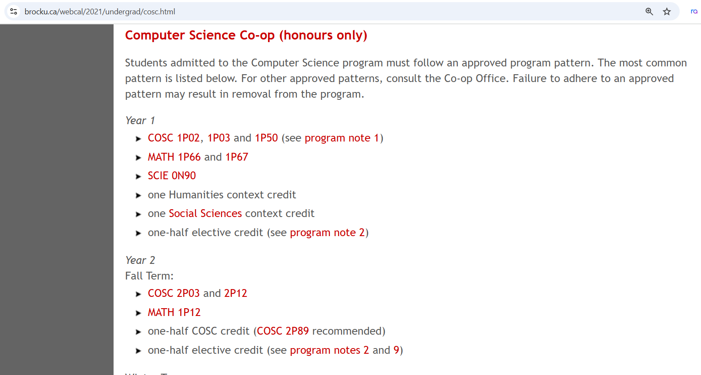
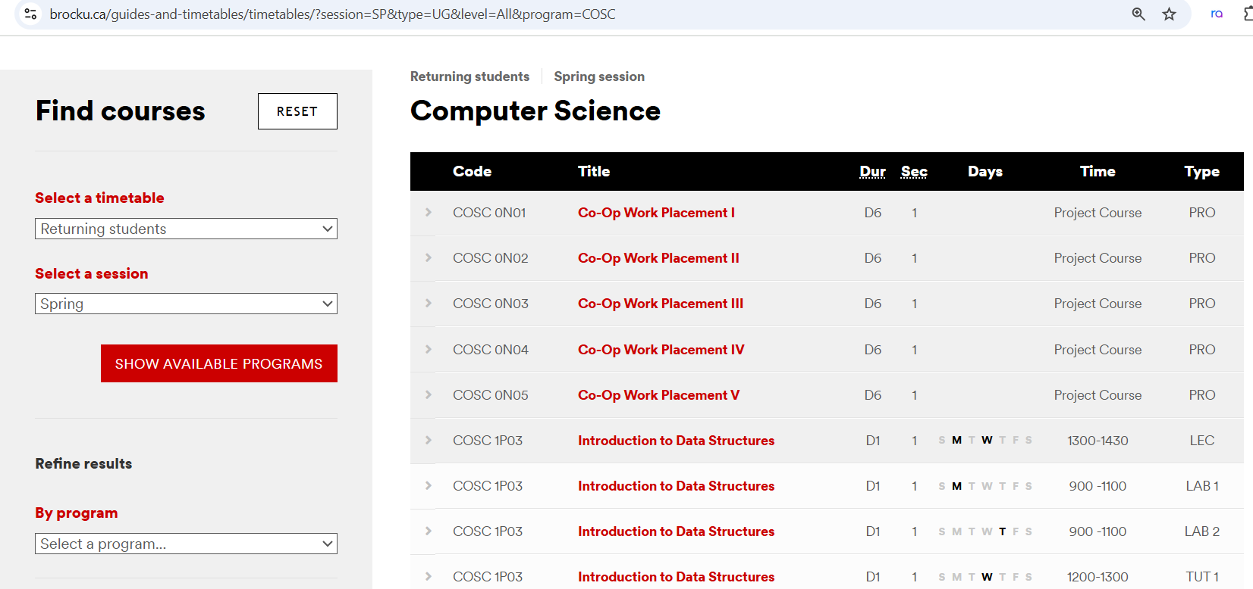
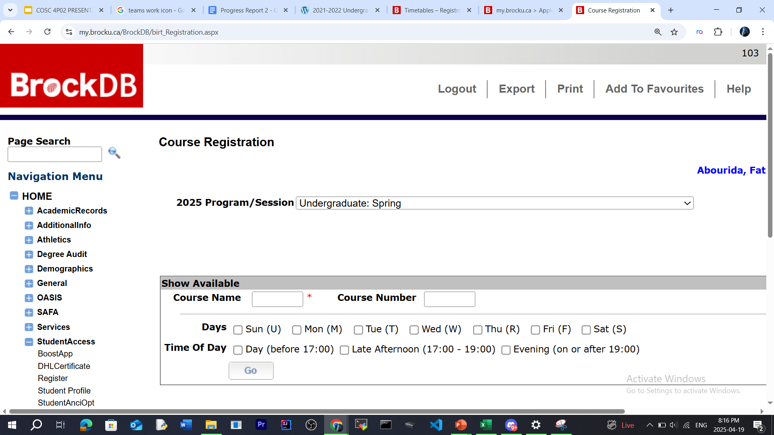
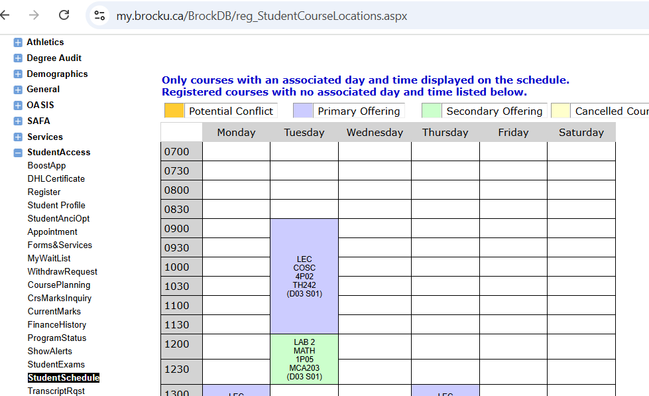
Introduction: Proposal
The Problem
Academic planning using scattered university tools
Course conflicts, missed requirements
Limited access to academic advisors
Connecting with others in the course
Our Solution
Map out entire degree using real data and preferences
24/7 Automates schedule creation, visualizes conflicts
Access to course discussions and reviews
Our Vision
Revolutionizing academic advising with data-driven solutions
Notes:
Fatima:
Right now, academic planning at Brock is scattered across several platforms. You need to check program requirements using the program timetable, see course offerings through the course timetable, register for courses on the registration page in the portal, and then go to a separate page, the student schedule to see if there are conflicts and visualize your schedule.
On top of that, it’s not always possible to meet with an academic advisor. Appointments can be fully booked, which leaves students on their own to make big decisions.
Plus, there are other challenges, like missing a lecture and having no one to ask because you don’t know anyone in the course. Or registering for a course without knowing whether it’s going to be difficult.
Course Mix brings all of this into one place. It maps your entire degree using your real data and preferences. It automatically generates your schedule, flags conflicts, and gives you access to community features like course discussions so you can connect with others in your classes.
You’ll also find a course feedback page where you can read reviews and difficulty ratings before registering.
Ultimately, Course Mix functions like a 24/7 academic advisor, but with the added benefit of convenience, community support, and data-driven insight—all on one centralized platform.

Slide 4

Team Work Process
Agile Workflow
Followed Scrum methodology for flexible, iterative development
Scrum Master sets up meetings and aligns team goals
Objectives are planned with the Product Owner
Task Division & Planning
Tasks are divided collaboratively in a shared Google Doc
Roles and workload are evenly distributed
Meeting Schedule
Weekly meetings every Tuesday
Friday meetings held before major submissions for final review
Notes:
Fatima:
Our team followed an Agile approach using the Scrum methodology. As the Scrum Master, I scheduled regular meetings and coordinated with our Product Owner to determine the objectives for each one.
We use shared Google Doc to collaboratively divide tasks. Each task was outlined clearly, ensuring transparency and a balanced workload across the team. Everyone knew their responsibilities and could track progress easily.
We held weekly meetings every Tuesday to discuss updates and challenges. If a deliverable or report was due, we also scheduled a Friday meeting to review the document as a team before submitting.
This routine helped keep everyone accountable and aligned, and allowed us to adapt quickly to any feedback or changes along the way.

Slide 5
Architecture: Implementation
How we built it?
Using NextJS
Supabase for the database
Resend for emails
Tailwind CSS for styling
Vercel to host the site (CNAME and DNS Record Linking)
Much better performance vs standard Brock platforms
Notes:
Ashu

Slide 6
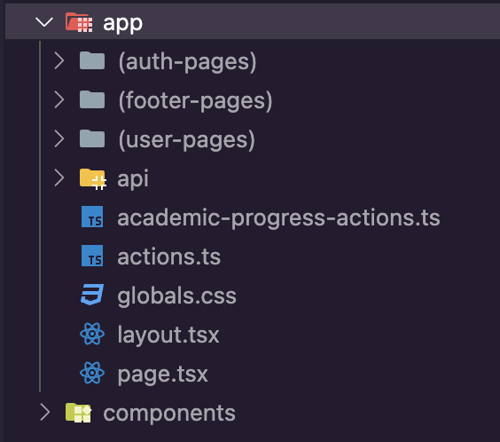
Implementation Continued
Structured folders for simpler development navigations
Each route (coursemix.ca/(route) has its own folder and page file.
Components folder also has many subfolders for each pages specific components

Slide 7
Architecture: Database
Many specific tables in a relational db
Use of foreign keys to add relationships to relevant data
Table layout currently provides easy room for scalability with minimal refactoring
Potential to expand from outside of Brock with the addition of a few rows and tables as well
Notes:
Ashu + Avi + Jerome

Slide 8
Architecture: AI Use
AI usage boosted productivity exponentially
Models rapidly evolved throughout the term, initially we started with using Claude 3.5 in Cursor
Claude 3.7 released midway through the development, and then in the end, Gemini 2.5 gave very good results
LLM plateau
Our AI cycle (Design - technical requirements - prompt - generated code - review code - manual tweaks)
Notes:
Ashu + Avi + Jerome

Slide 9
SE Activities: Requirements
Agile Framework: Scrum
We adopted Scrum as our development methodology to effectively manage complexity through short, focused iterations. Work is organized into sprints—time-boxed cycles (typically two-week increments), each delivering a shippable slice of functionality. For instance, one sprint might focus on implementing course selection workflows, the next on course review features, and a subsequent one on dynamic plan adjustments along with integrated chat and course rating functionalities.
Notes:
We utilized SCRUM for project timeline. Our project timetable (from proposal) embeds key milestones—proposal submission, release‐planning document, progress reports, final report, and demonstration—into regular sprints, ensuring that deliverables and documentation evolve in lock‑step with the codebase

Slide 10
SE Activities: Requirements
Backlog & Task Management: Jira and Github
All requirements were documented as user stories in Jira, written from the student’s perspective (e.g., “As a student, I want to see my program’s remaining requirements so I can plan next term”). These stories were then broken into smaller, actionable tasks, estimated, and prioritized for upcoming sprints. Jira’s dashboards and burndown charts helped keep the team aligned and made progress easily trackable. Additionally, we used GitHub Issues to monitor and resolve open items raised during team meetings.
Notes:
version control and We use Git for source control and collaboration:
Feature branches: Each new story/task lives in its own branch.
Pull requests: Completed work is merged into main only after a peer review, ensuring code quality and reducing integration conflicts.
History & rollback: Git’s full history allows us to revert changes if issues arise

Slide 11
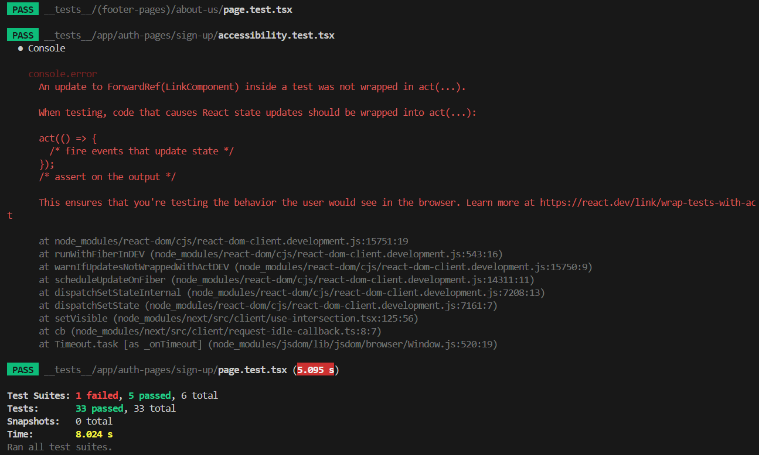
SE Activities: Software Testing

Slide 12
SE Activities: Software Testing
For testing, we used the Jest framework to ensure code reliability and maintain high-quality standards throughout development. Jest’s simplicity and powerful features, such as built-in mocking, made it ideal for testing JavaScript-based components. We wrote unit tests for core functionalities—such as course selection logic and schedule generation—to catch regressions early and validate expected behaviors.
Notes:
Jest’s mocking capabilities allowed us to isolate and test individual components without relying on real data or external dependencies. By simulating functions, API calls, or modules, we could verify how components behaved under different scenarios without needing a full backend or database. This made our tests faster, more reliable, and easier to debug. regressions refer to bugs or issues that appear in previously working features after new code changes have been made. In other words, a regression is when something that used to work—like a button, a function, or a page layout—breaks unintentionally due to updates or new features being introduced.
For example, if you add a new feature for course reviews and suddenly the course selection page stops loading correctly, that would be considered a regression. Regression testing is the process of checking that existing functionalities still work after changes are made.

Slide 13
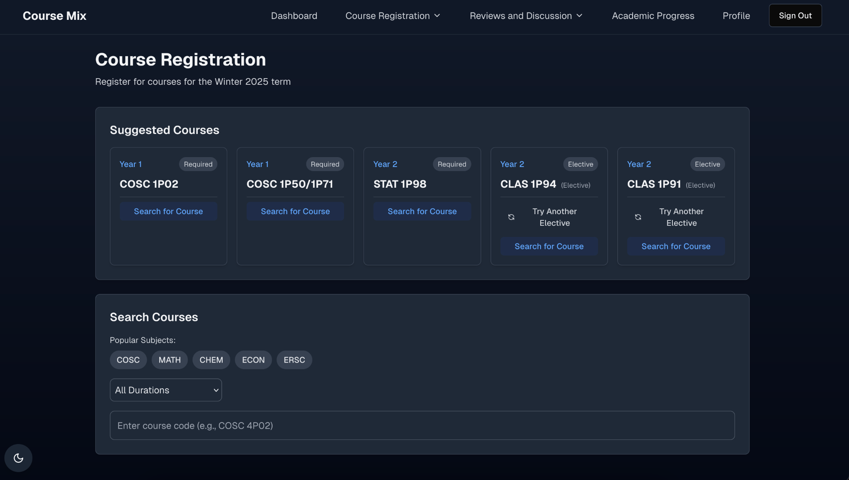
SE Activities: Course Registration
Searching for courses searches for all courses offered at Brock currently
These must be refreshed yearly to ensure up to date courses are in the database
Suggested courses is dependent on your current position in your degree
Suggested courses algorithm
Notes:
Ashu + Avi

Slide 14
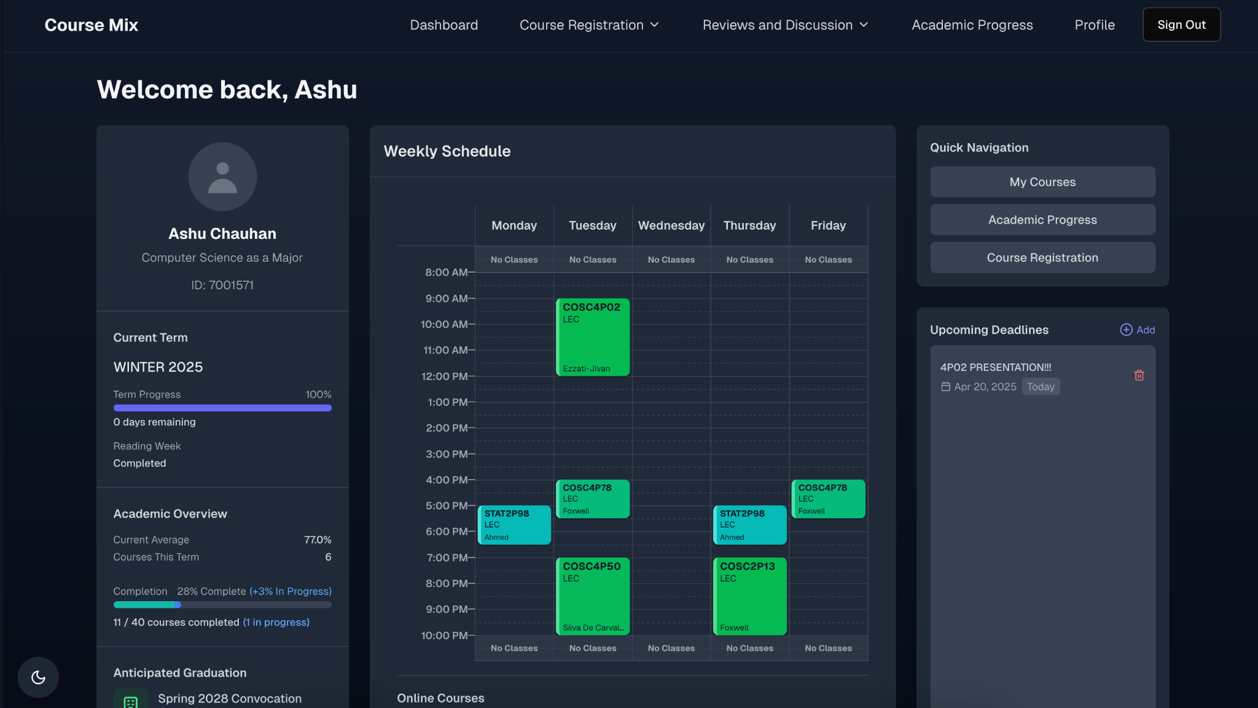
SE Activities: Design - Dashboard
All in one dashboard
Key statistics (projected graduation, term tracker, on campus weather)
Visually appealing timetable
Upcoming deadlines tab
Serves as a nice hub for your academic needs
Notes:
Ashu + Avi

Slide 15
SE Activities: Design - Projected Graduation Algorithm
Assumes students will take 5 courses each term
Only for Fall and Winter terms, Spring/Summer courses are bonus and not counted in the tracker
Estimates the target completion of course work based on 5/term amount
Finds the nearest convocation ceremony to that date
Projects the nearest convocation (Oct or June) after classes are expected to be completed.
All this data is from the Academic Progress page
Notes:
Ashu

Slide 16
Limitations
Limited data results in significant limitations in the product we can build
Suggested courses could factor in students target GPA and use historical course data to suggest more relevant courses based on difficulty (a ML approach can be utilized here)
Similar concept for projected graduation where instead of a specific algorithm, we can use historical trends in how students progress to give a more “smart” projection
Ultimately, data constraints limit what we can build, but I believe we have built something that we are proud of with the data we had
Notes:
Ashu

Slide 17
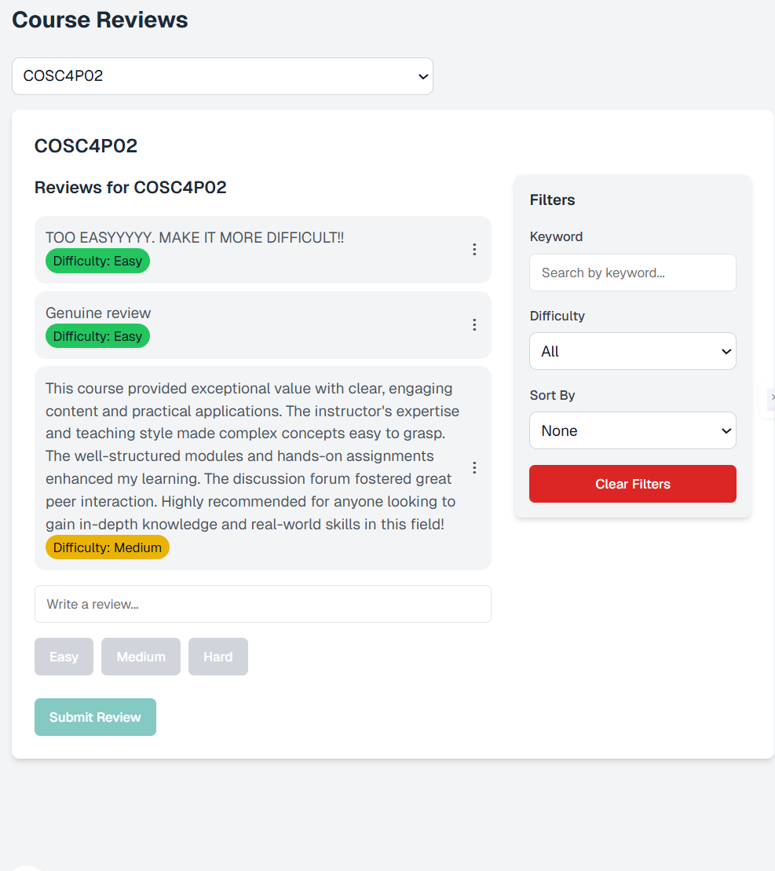
SE Activities: Design - Course Reviews
Built to support open conversation around specific courses
Structured text input with support for editing and copying text
Filtering and sorting to keep discussions organized
Profanity detection to maintain respectful dialogue
UI designed for clarity, readability, and ease of use
Reusable components for consistency across the platform
Emphasized student engagement and safe interaction
Notes:
Jerome

Slide 18
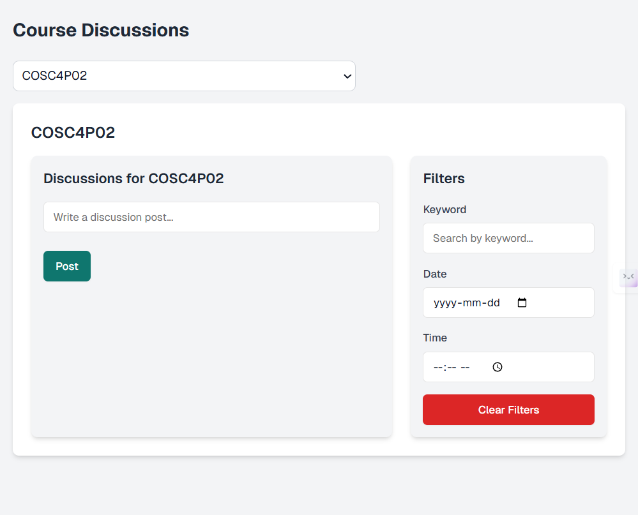
SE Activities: Design - Course Discussions
Designed to collect student feedback on enrolled courses
Simple and clean UI with dropdown course selection
Structured input for reviews with difficulty tagging
Added filtering and sorting for better navigation
Integrated profanity detection for safe content
Components built with reusability and maintainability in mind
Focused on usability and smooth user experience
Notes:
Jerome

Slide 19
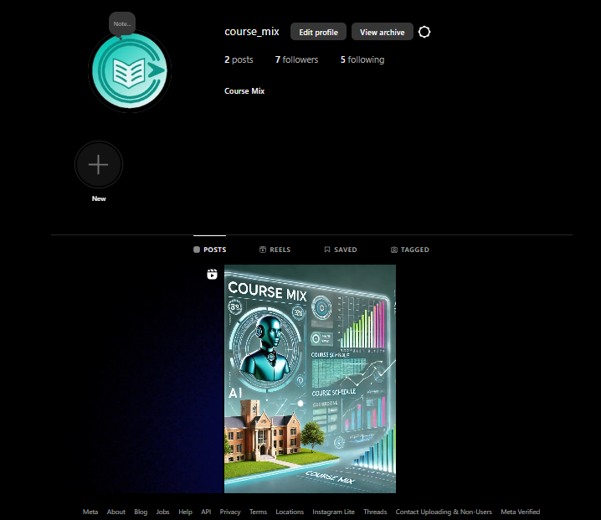
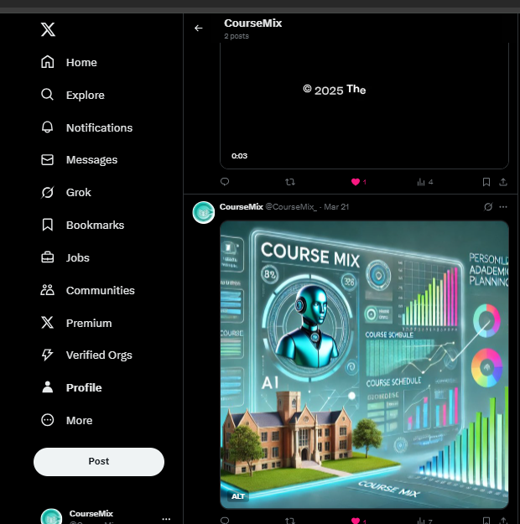
Marketing: Social Media
AI-generated and human-written content tested
Performance nearly identical across both types
Experimentation ongoing for optimal engagement
Notes:
Ore:
As part of our go-to-market strategy, we’ve been actively experimenting on social media with both AI-generated and human-made content. Surprisingly, they’re performing about the same in terms of engagement, an encouraging sign that our messaging resonates no matter the source. Looking ahead, more A/B testing is on the way to refine what performs best.

Slide 20

Marketing: Product Launch Video
Notes:
Ore: The goal of this video is to highlight the app’s key features, demonstrate how it solves real student problems, and show how easy it is to navigate.
It’s designed to appeal to both new users and stakeholders, and serves as a visual walkthrough for anyone curious about how Course Mix can transform their academic planning.
So without further ado, here’s our official launch video!

Slide 21
Contribution: Github
 | Ashu | Avi | Fatima | Jerome | Kitan | Ola | Russell
Commits merged to main | 100 | 67 | 6 | 28 |  | 6 | 15
Commits not merged | 15 | 10 |  |  | 6 | 6
“Taken merges” |  |  | 4 | 10 | 5 |  | 10
Notes:
When presenting:
Explain each of these columns in more detail. “Taken” merges refer to the bug we found with pull requests where only the pull request maker gets all the credit in the Contributions tab.
Russell

Slide 22
Contribution: Supabase
 | Ashu | Avi | Fatima | Jerome | Kitan | Ola | Russell
Tables created | 4 | 4 | 2 | 2 | 1 | 2 | 2
Rows inserted (approx) | 300 | 300 | 200 | 600 | 800 | 500 | 200
Notes:
When presenting:
Explain why Rows Inserted must be approximated (Supabase only gives an estimated number of rows)
Russell

Slide 23
Thank You !
Any Questions ?
The Mixers
Notes:
Fatima:
Thank you for listening, I’ll hand it over to Ashu for the live demo

